Slide 1
Internship at THE WEB BLINDERS
Name: Adike Arun Kumar
Roll No: 219X1A3333
Position: Python and Data Science Intern Duration: 3 – 4 months

Slide 2
About the Company
The Web Blinders is a leading software company based in Hyderabad, Andhra Pradesh.
From bespoke web development to cutting-edge AI solutions, The Web Blinders specializes in a diverse range of services tailored to their clients' needs. Whether it involves crafting intuitive websites, developing robust e-commerce platforms, harnessing machine learning for predictive analytics, or deploying chatbots for enhanced customer engagement, their expert team ensures top-notch solutions at every step. With a focus on innovation and efficiency, they empower businesses to thrive in the ever-evolving digital landscape.
For more details: http://www.thewebblinders.in

Slide 3
Internship Role & Responsibilities
Role: Junior Full Stack Web Developer
Responsibilities:-
I will be deeply working on machine learning algorithms using Python, with a detailed study of Algorithms.
Till now we have had sessions on the basics of Python and from this week EDA and statistics will be starting.

Slide 4
Tools & Technologies Used
Programming Language: Python
Libraries and Frameworks: NumPy, Pandas, Matplotlib, Seaborn, Scikit-learn, TensorFlow/PyTorch,
Database: MySQL, MongoDB
IDEs: Jupyter Notebook, Google Colab
Version Control: Git

Slide 5
Skills Required
Technical Skills- Python
Machine Learning,
MySQL, MongoDB
Git
Soft Skills- Team Collaboration
Problem-solving
Time Management

Slide 6
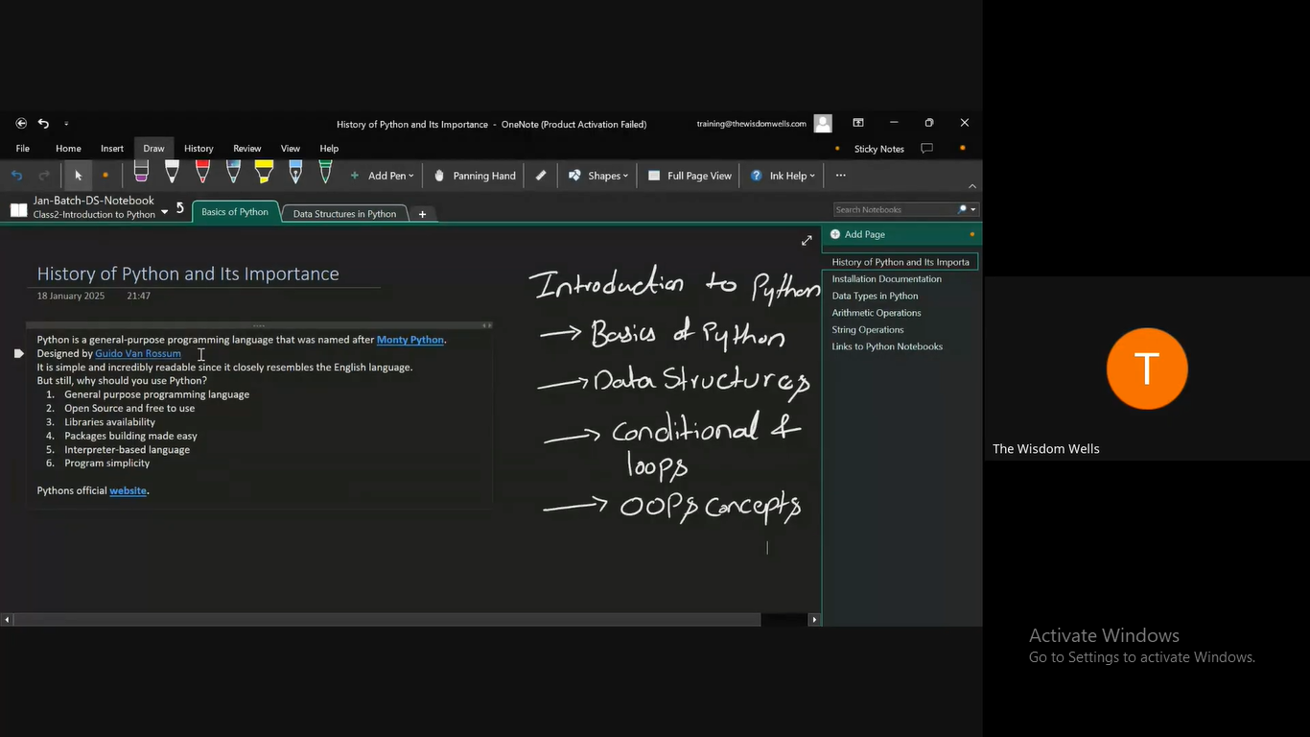
Week - 1

Slide 7
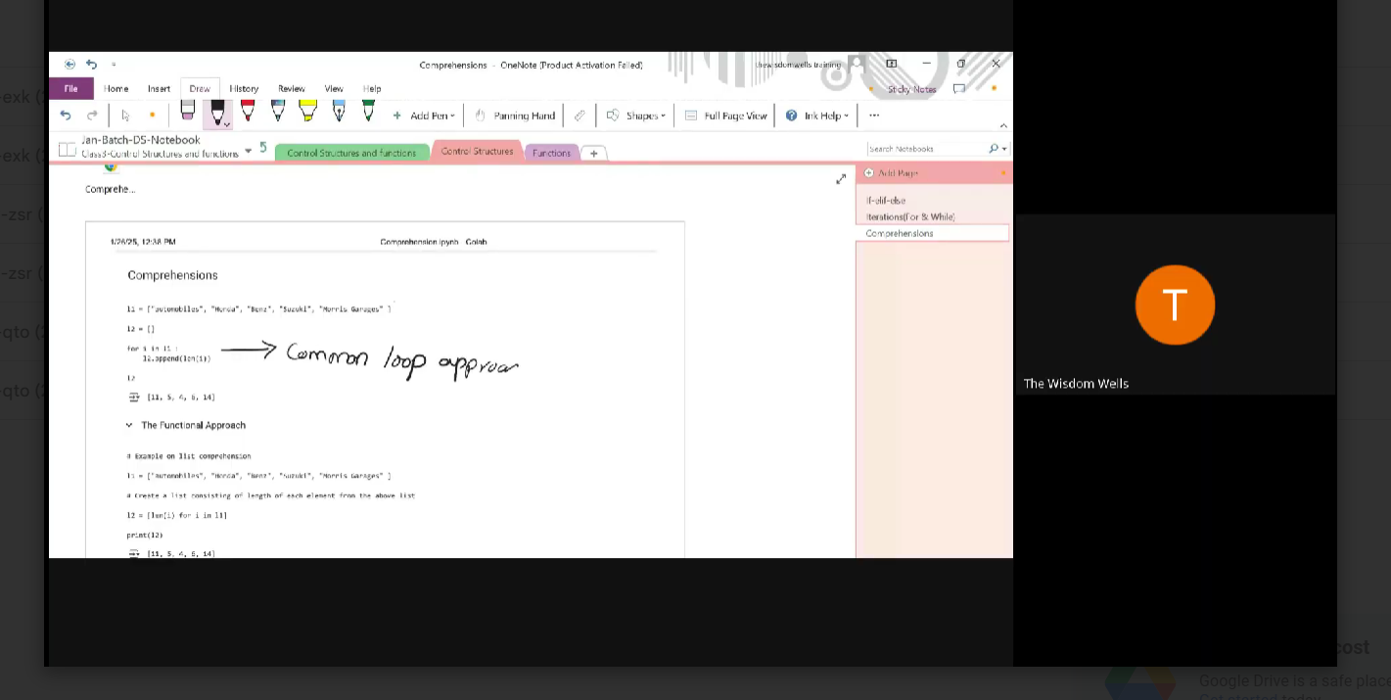
Week - 2

Slide 8
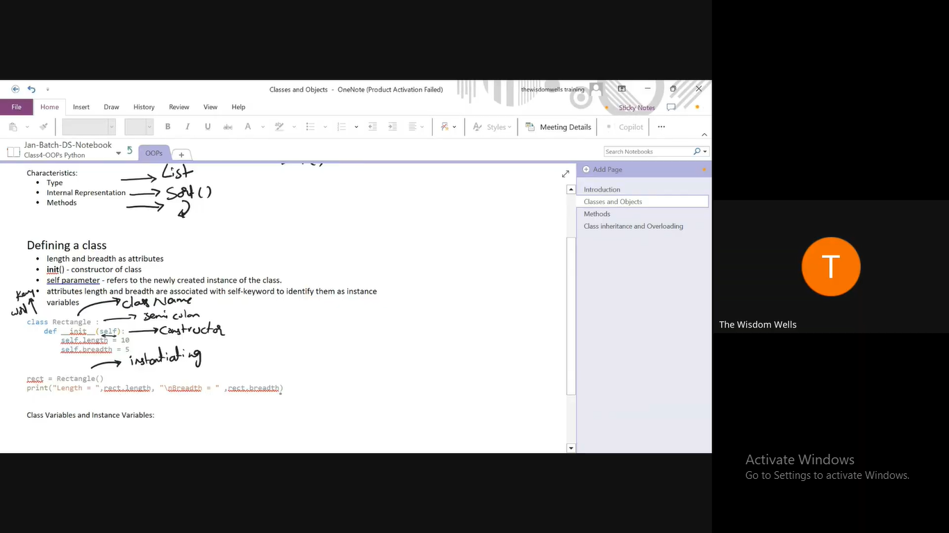
Week - 3

Slide 9
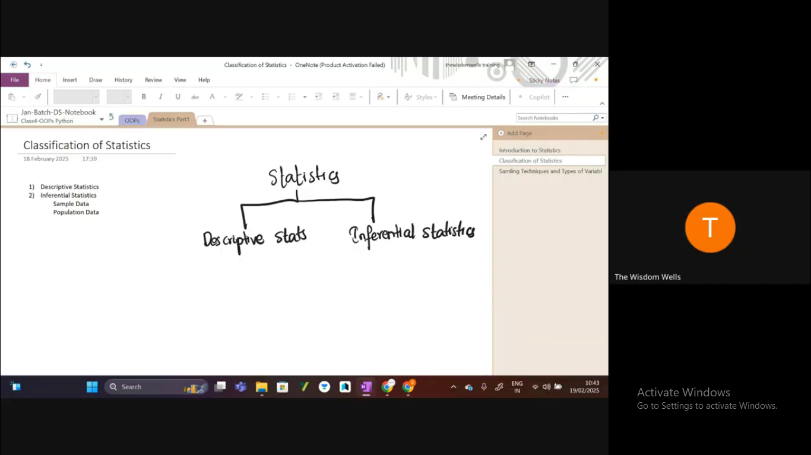
Week - 4

Slide 10
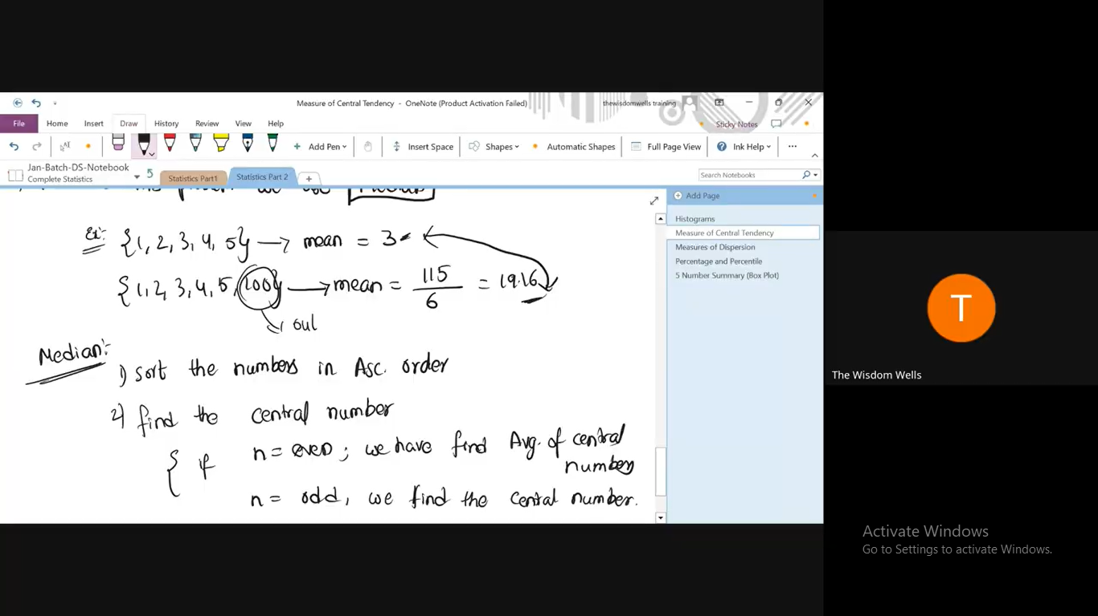
Week - 5

Slide 11
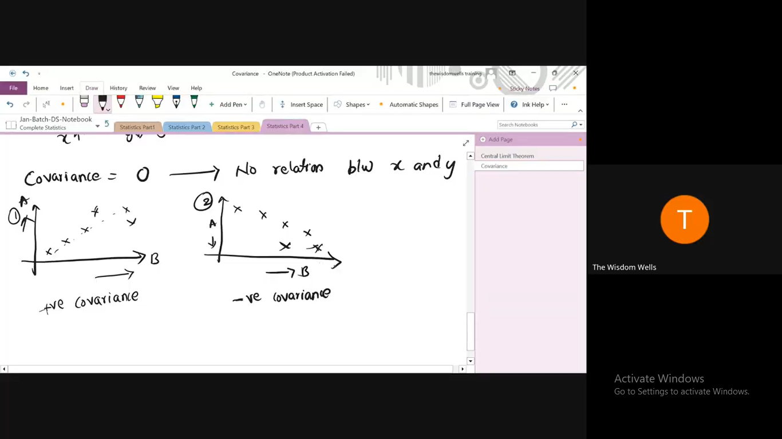
Week - 6

Slide 12
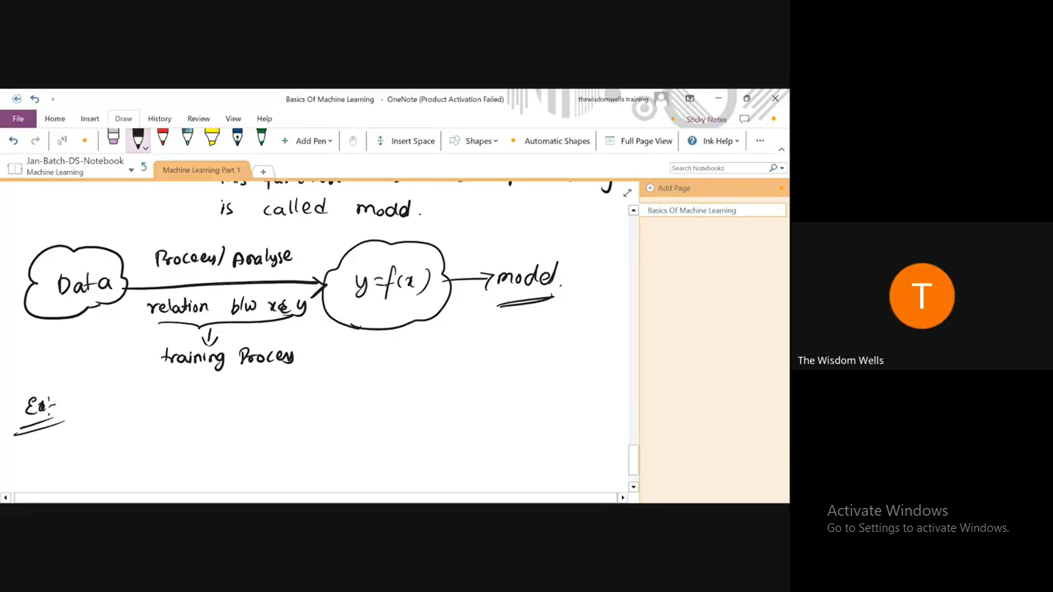
Week - 7

Slide 13
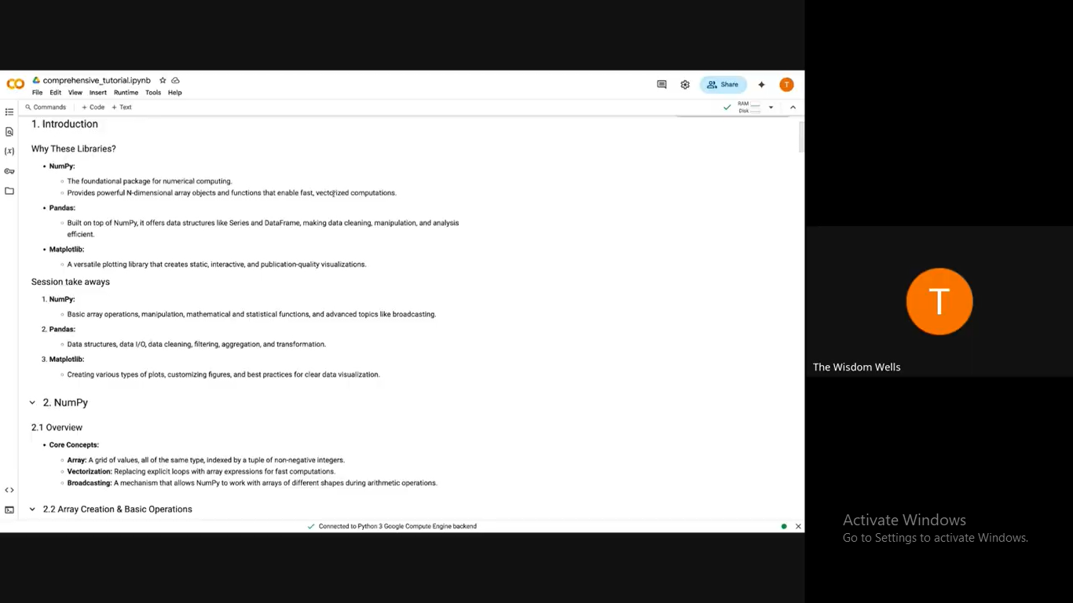
Week - 8

Slide 14
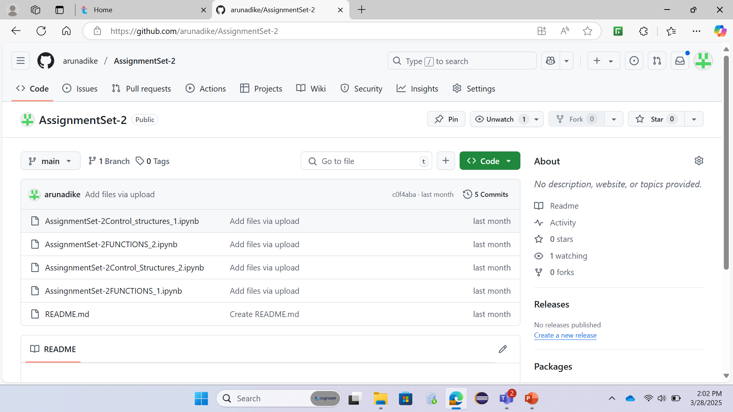
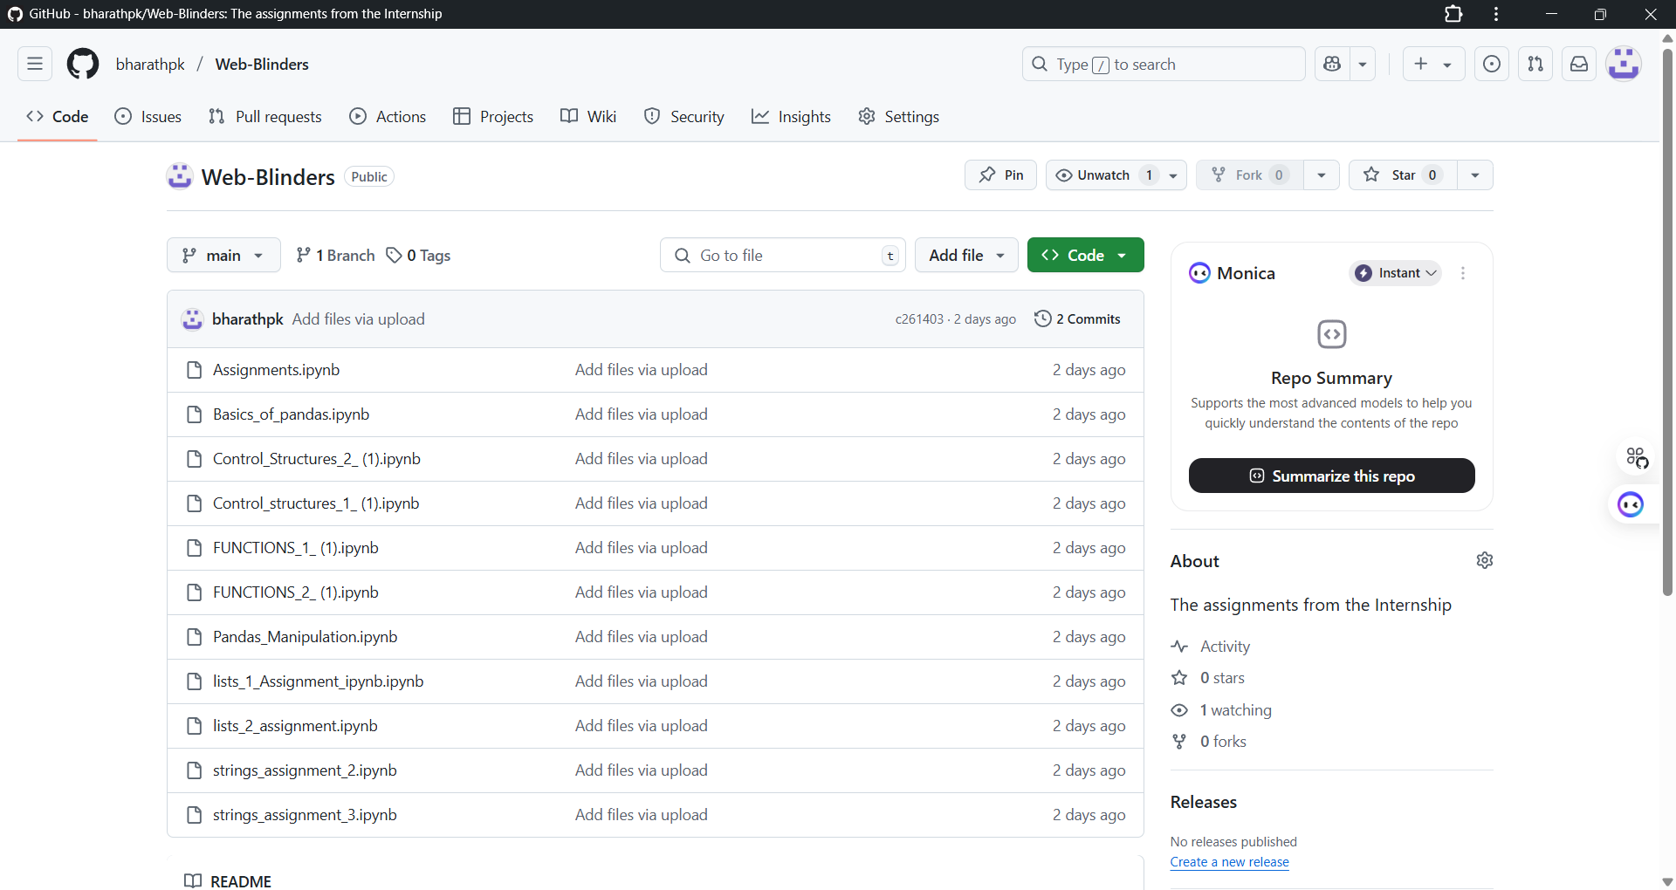
Assignment Links https://github.com/arunadike/AssignmentSet-2.git

Slide 15
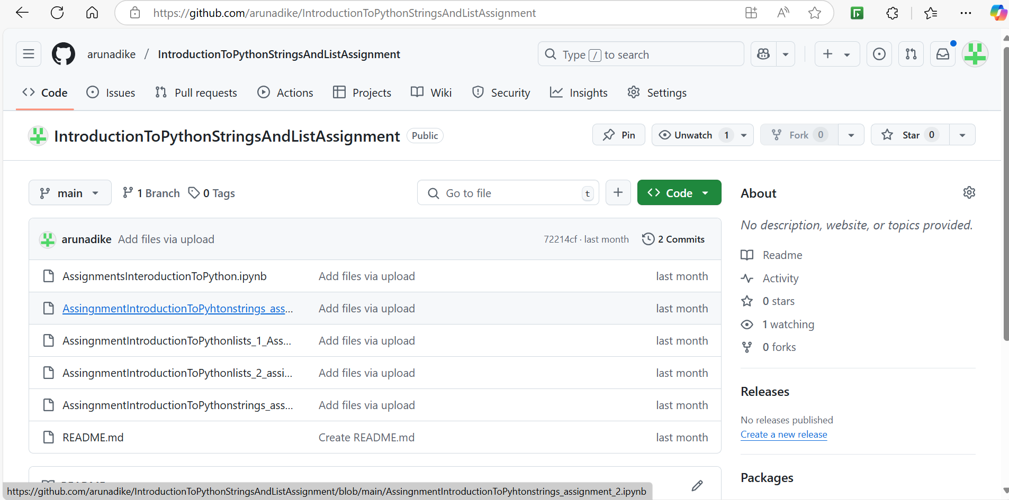
Assignment Links https://github.com/arunadike/IntroductionToPythonStringsAndListAssignment.git

Slide 16
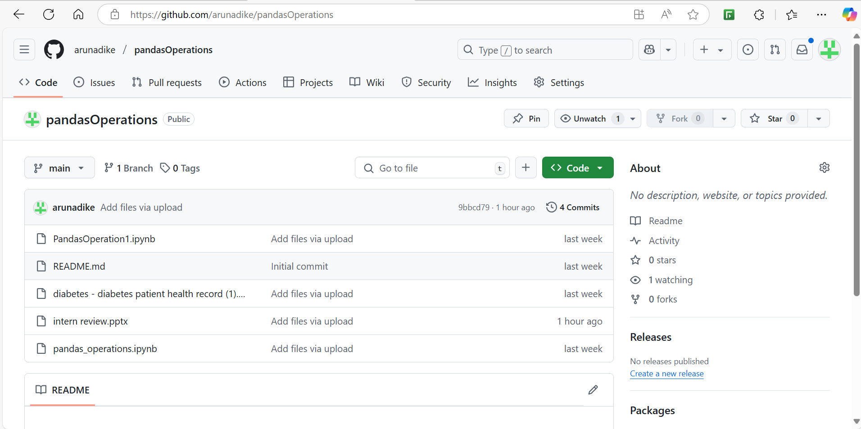
Assignment Links https://github.com/arunadike/pandasOperations.git

Slide 17
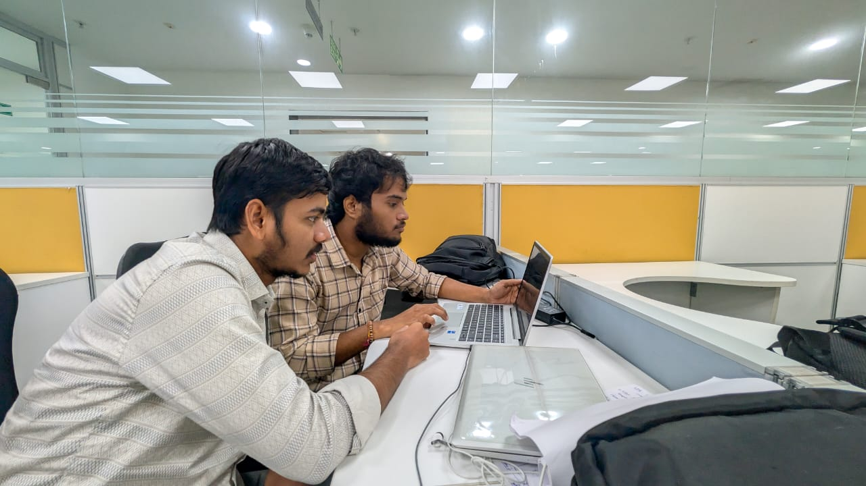
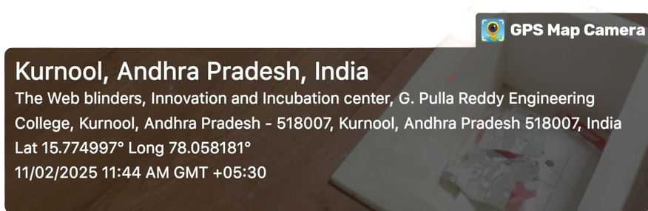
Images at workplace

Slide 18
Thank You

